Slide 1

Home
Workouts
ExerPals.com
People
Messaging
Welcome to ExerPals! The site where you can find like-minded people near you to exercise and grow with.
To find workouts happening near you, click here!
For people looking for workout partners or groups, click here!
For the messaging page, please click here!
EP

Slide 2
Home
Workouts
ExerPals.com
People
Messaging
Find Workouts near you!
Enter your location…
Search
EP

Slide 3
Home
Workouts
ExerPals.com
People
Messaging
Error: Please Enter your location!
Find Workouts near you!
Enter your location…
Search
EP

Slide 4
Home
Workouts
ExerPals.com
People
Messaging
Find Workouts near you!
Charlotte, NC
Search
EP

Slide 5
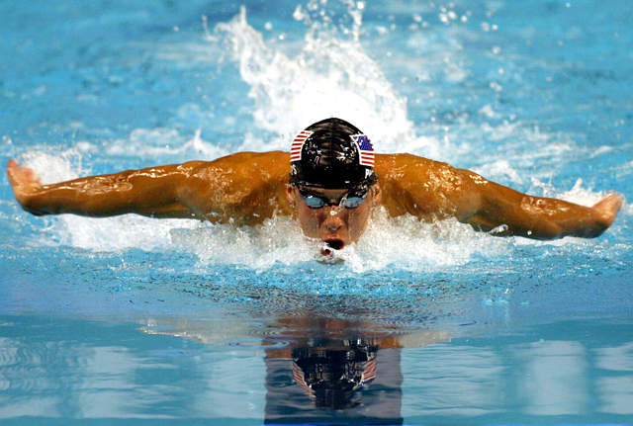
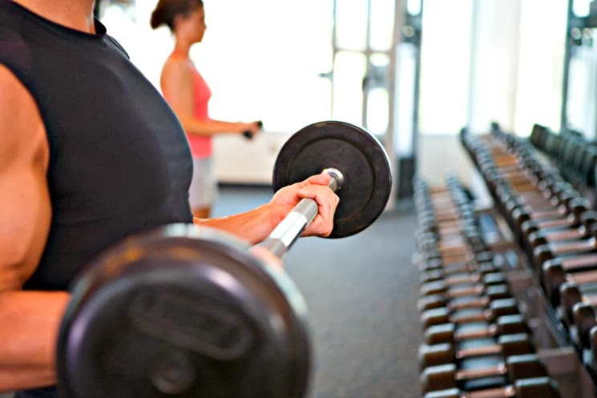
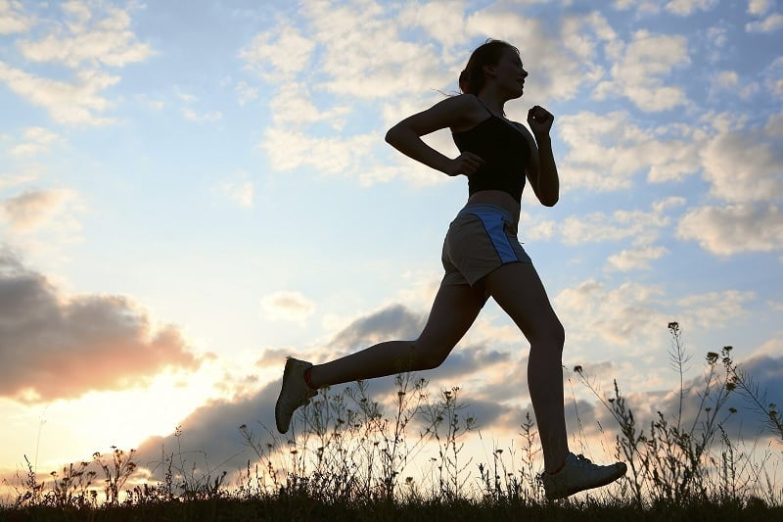

Home
Workouts
ExerPals.com
People
Messaging
Workouts available in Charlotte, NC
Swimming at the YMCA
Lifting Weights at Planet Fitness
Running at Park Road Park
Tennis at UNC Charlotte
EP
Change Location

Slide 6
Home
Workouts
ExerPals.com
People
Messaging
Bob
Active now: one new message
Amy
Last active 2 hours ago
Josh
Last active 4 hours ago
Anna
Last active yesterday
EP

Slide 7
Home
Workouts
ExerPals.com
People
Messaging
Find People near you!
Enter your location…
Search
EP

Slide 8
Home
Workouts
ExerPals.com
People
Messaging
Find People near you!
Charlotte, NC
Search
EP

Slide 9
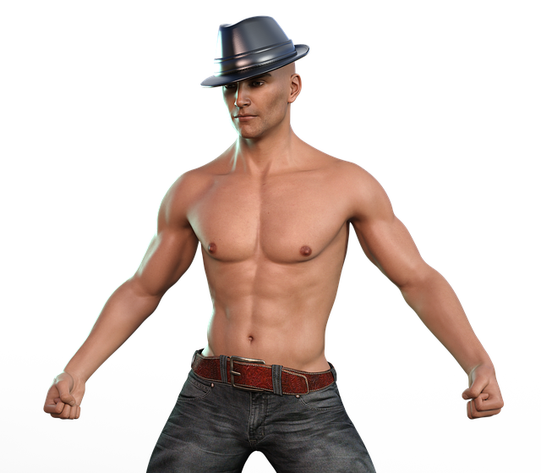
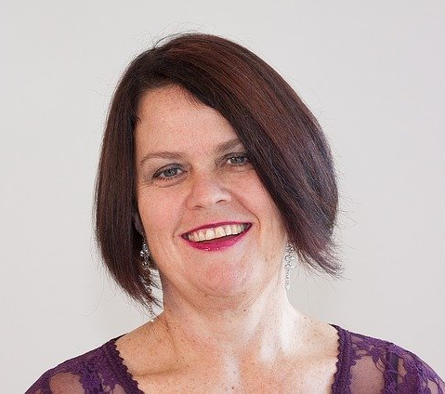
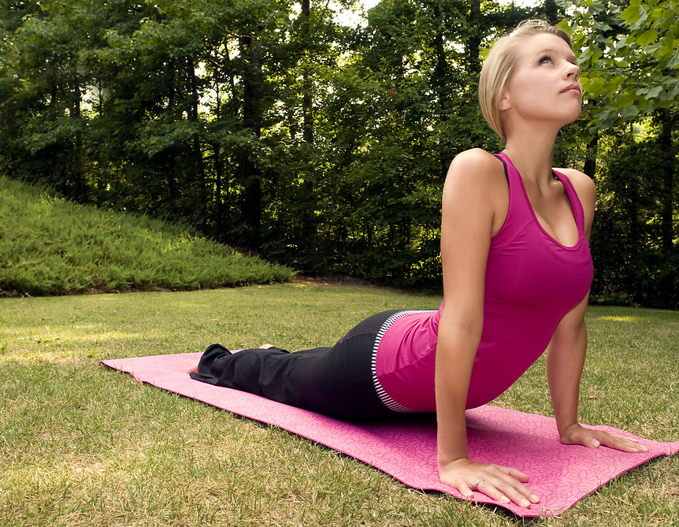

Home
ExerPals.com
People
Messaging
Workouts
People in Charlotte, NC
Mike, 28
Janet, 47
Madison, 19
Cory, 27
EP
Change Location

Slide 10
Home
Workouts
ExerPals.com
People
Messaging
Error: Please Enter your location!
Find People near you!
Enter your location…
Search
EP

